Slide 1
Entropy Distinctive signs of packed
Dao Tuan Linh, 30/07/2018

Slide 2
Goals
Understanding the concept of Entropy
Understanding how to use entropy in detect the packed file

Slide 3
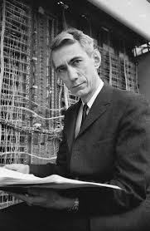
Information Entropy
In 1948, Claude E. Shannon introduced the revolutionary notion of Information Entropy in his paper called “A Mathematical Theory of Communication”

Slide 4
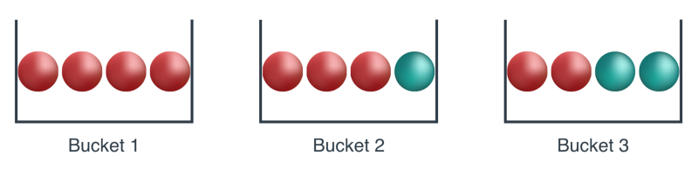
Entropy and Knowledge
Let’s say we have 3 buckets and 4 balls each :

Slide 5
In the first bucket, we’ll know for sure that the ball coming out is red.
In the second bucket, we know with 75% certainty that the ball is red, and with 25% certainty that it’s blue.
In the third bucket, we know with 50% certainty that the ball is red, and with the same certainty that it’s blue.

Slide 6
Conclusion
Bucket 1 give us the most amount of “knowledge” because we know for sure it’s red
Bucket 2 give us some “knowledge”
Bucket 3 give us least amount of “knowledge”
=> Entropy is in opposite of “knowledge”

Slide 7
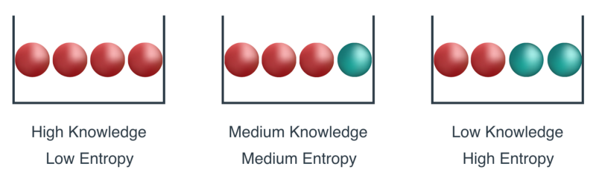

Slide 8
Let’s play a game
We choose one of the three buckets.
We are shown the balls in the bucket, in some order. Then, the balls go back in the bucket.
We then pick one ball out of the bucket, at a time, record the color, and return the ball back to the bucket.
If the colors recorded make the same sequence than the sequence of balls that we were shown at the beginning, then we win 1,000,000 dollars. If not, then we lose.

Slide 9
It’s easy
Let say that we picked the Bucket 2 and they show us the order : red, red, red, blue
If we get balls out of the Bucket 2 in this order, then we win.
So what’s the probability of this happening?

Slide 10
In order for the first ball to be red, the probability is 3/4, or 0.75.
For the second ball to be red, the probability is again 3/4. (Remember that we put the first ball back in the bucket after looking at its color.)
For the third ball to be red, the probability is again 3/4.
For the fourth ball to be blue, the probability is now 1/4, or 0.25.
As these are independent events, then the probability of the 4 of them to happen, is :
(3/4)*(3/4)*(3/4)*(1/4) = 27/256, or 0.105

Slide 11
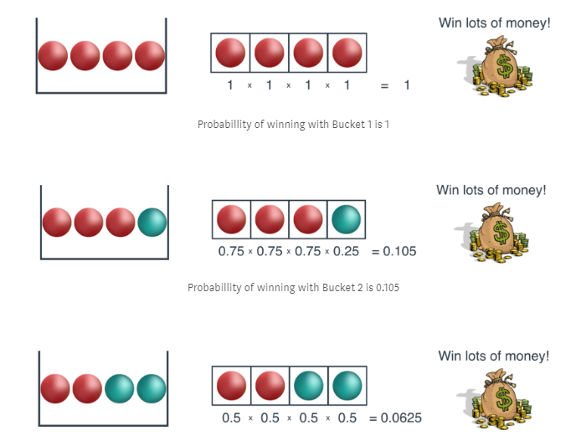

Slide 12
Cooking the Entropy Formula
1.0 for Bucket 1
0.105 for Bucket 2
0.0625 for Bucket 3
In order to build the entropy formula, we want the opposite, some measure that gives us a low number for Bucket 1, a medium number for Bucket 2, and a high number for Bucket 3.
No problem, this is where logarithms will come to save our life.

Slide 13
Turning Products into Sums
The following is a very simple trick, yet used very widely, particularly in Machine Learning. See, products are never very good. Here we have a product of 4 numbers, which is not bad, but imagine if we had a million data points.
How would the product of a million small probabilities (between 0 and 1) would look?
It would be a ridiculously tiny number.
In general we want to avoid products as much as we can. What’s better than a product?
Well, a sum!
How do we turn products into sums? Exactly, using the logarithm function

Slide 14

Remember your logarithm

Slide 15


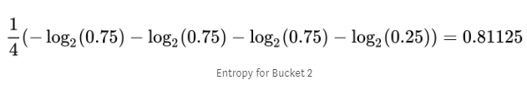
What do we do?
We have a product of four things, we take the logarithm, and that becomes the sum of four things. In the case of Bucket 2 (3 red balls, 1 blue ball), we have the following:
And taking the logarithm (in this case, we’ll take the logarithm, and multiply by -1, to make things positive), we get:
Now, as a final step, we take the average, in order to normalize. And that’s it, that’s the entropy! For Bucket 2, it’s 0.81125:

Slide 16
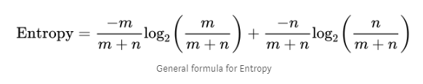
General Formula
For formula lover ☺

Slide 17
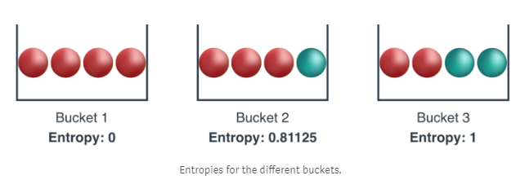
Calculate them all

Slide 18
Packer, Protector
"Packer" is a common name for programs which only compress executable files..
"Protectors" are program, using for the protection of executable files cryptography and anti-debugging techniques.
In fact, the boundaries between these types of programs are blurred. There are both packers with anti-debugging and protectors enabled to pack files.

Slide 19
How to detect it?
Non-standard names of sections
Specifications of sections
Address of the entry point
Presence of certain functions in the import
Increased entropy

Slide 20

Let’s analyse the samples
http://www.nothink.org/honeypots/malware-archives/

Slide 21
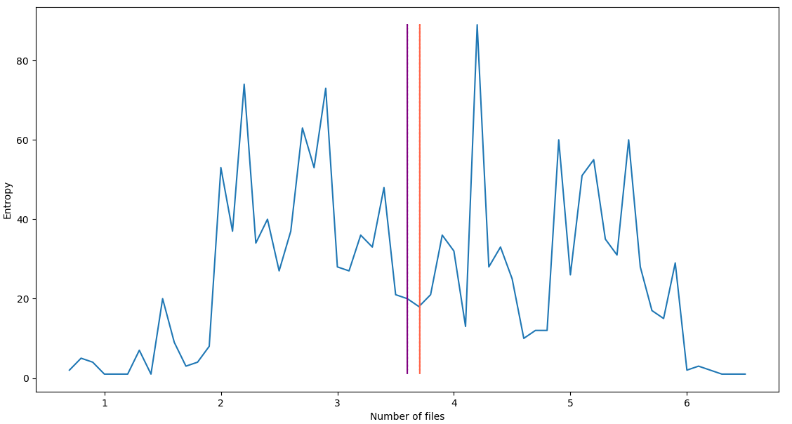
2012
1514 files – 470MB

Slide 22
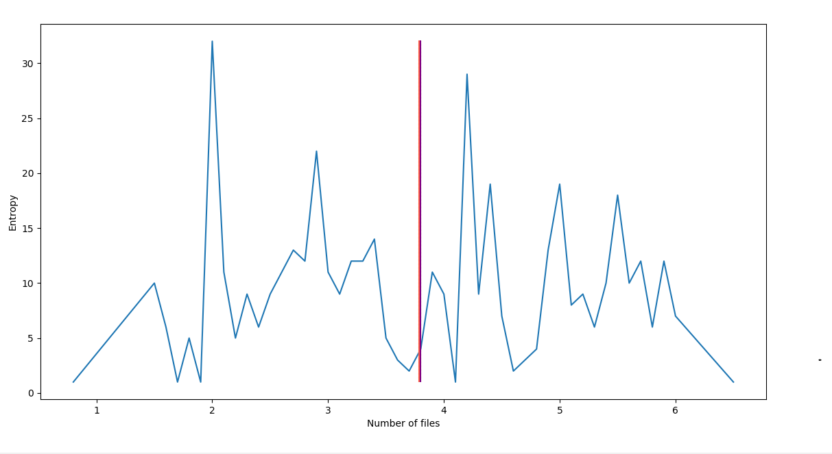
2013
451 files – 186 MB

Slide 23
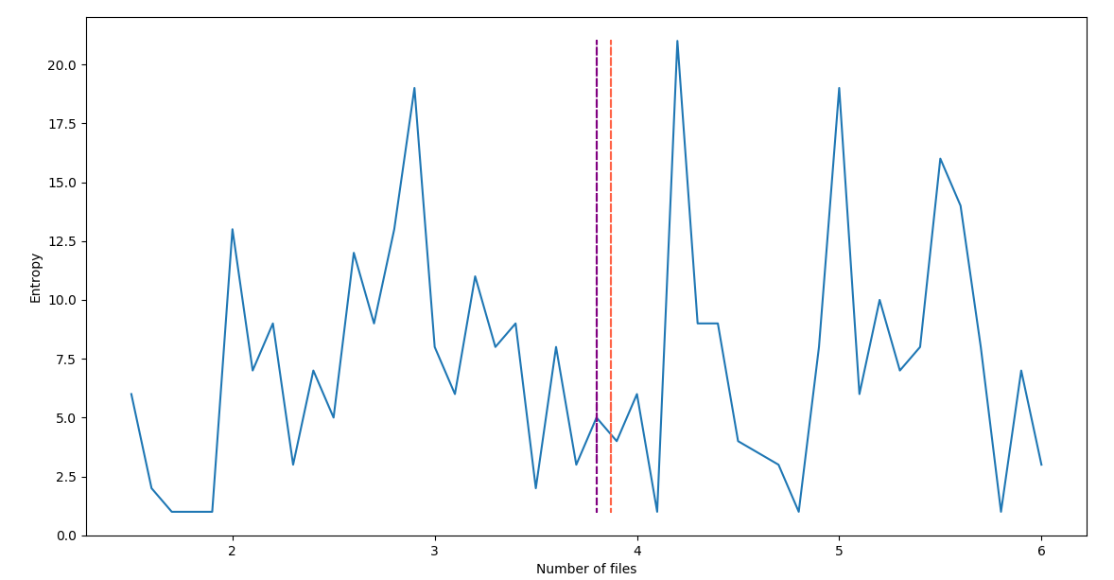
2014
1514 files – 149 MB

Slide 24
Conclusion
So we can see the medium and median value is about 3.8, with graph, we can say :
The file with entropy above 6 is high likely packed
The file with entropy under 2 is high likely obfucasted
Is it right!?

Slide 25
Reality
Actually, we cannot give conclusion like that.
The boundary entropy value when the data is about to be considered packed is unclear.
Some programs value it 6.0, others - 6.5 or 7.0 (on a scale of 0 to 8).

Slide 26
But…
It’s still can be one of checkpoints for us to see if file is packed

Slide 27
But…
It’s easy to bypass
Example : adding NULL byte after EOF will help reduce the entropy

Slide 28
But…
We just need to exclude NULL byte ☺

Slide 29
But…
Malware coder still can add junk code into their malware to increase Entropy
But it’s another story, I don’t want to go too far from our first point ☺

Slide 30
Why our analysis is wrong?
It’s not WRONG. We just don’t have BIG ENOUGH sample
Let’s calculate the average file size of 2012
(470 * 1024)/1534 = 314KB. See the point?

Slide 31
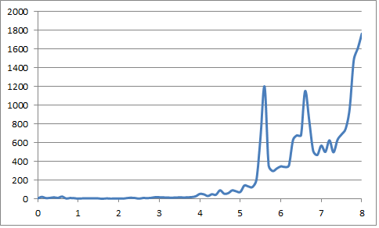
Another analysis
Analysis with ~20000 samples. Average is 6.8.

Slide 32
Resources
https://n10info.blogspot.com/2014/06/entropy-and-distinctive-signs-of-packed.html
https://medium.com/udacity/shannon-entropy-information-gain-and-picking-balls-from-buckets-5810d35d54b4
https://en.wiktionary.org/wiki/Shannon_entropy
http://www.nothink.org/honeypots/malware-archives/
The Mathematical Theory of Communication – Claude E. Shannon

